Slide 1

Solar System Simulation in Python.
A Python Project to Visualize the Solar System Calculate, Travel Metrics and distance in Au.
Created by :Muhammad Tahseen Nazar.
Supervisors : eman sajid.

Slide 2
Project Objectives
- Visualize the 2D model of the Solar System
- Show planetary orbits and positions
- Calculate distances between Earth and other planets
- Estimate travel time for a spacecraft

Slide 3
Key Features
- Dynamic calculation of planetary positions
- Circular orbit visualization
- Distance from Earth to other planets
- Travel time calculation at 50,000 km/h
- Real-time updates based on the current date

Slide 4
Methodology
1. Data Input:
- Orbital distances (AU) and periods (Earth years)
2. Calculations:
- Planet positions using trigonometry
- Distance using Euclidean formula
- Travel time using speed and distance
3. Visualization:
- Plot using matplotlib
- Annotate planet positions and orbits

Slide 5
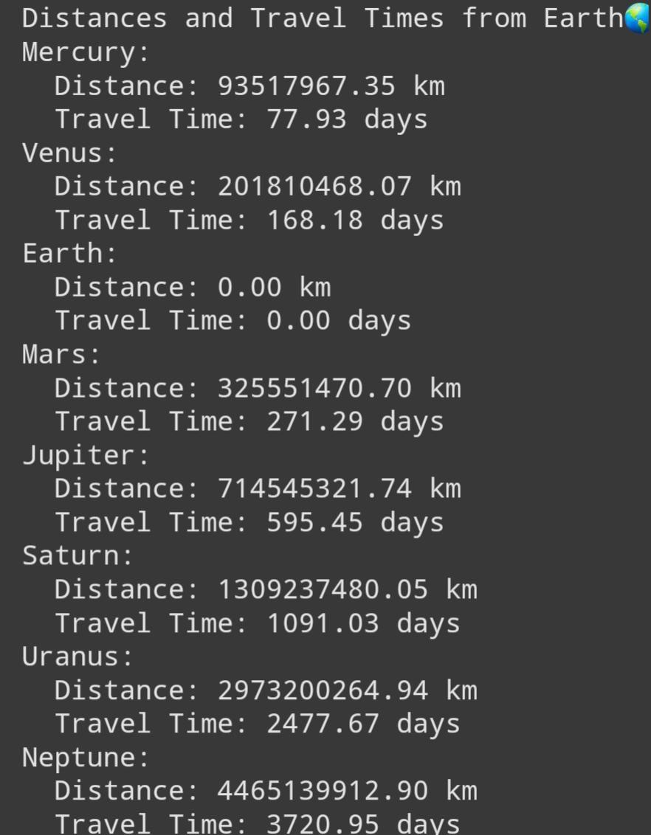
Results Output..

Slide 6
Code Highlights
- Python libraries used:
- matplotlib: For plotting the solar system
- datetime: To calculate time elapsed
- Key functions:
- `calculate_position`: For planetary positions
- `calculate_distance_and_time`: For distance and travel time

Slide 7
The program dynamically plots planetary orbits and positions based on the current date. These timelines are given below slides.

Slide 8
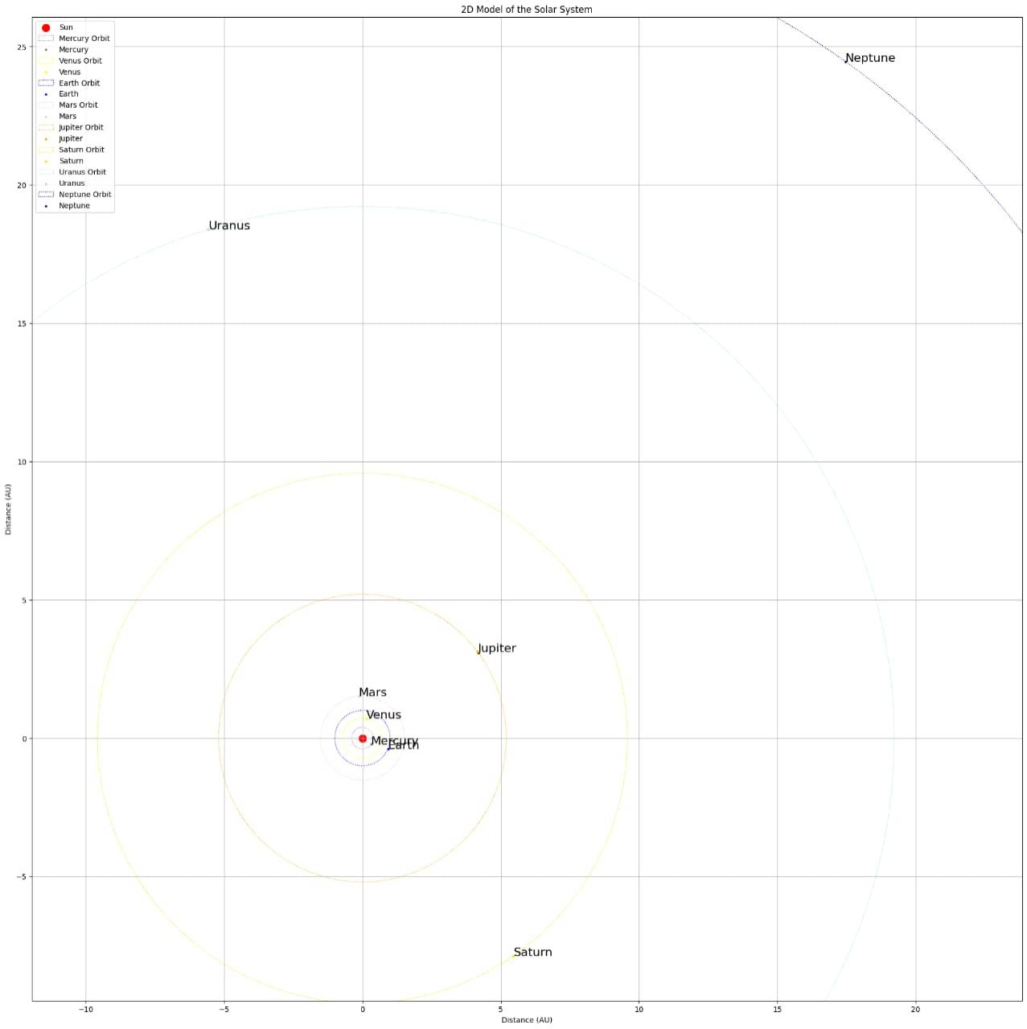
Timelines how your solar system looks in 2D. In 2 Feb 2004.

Slide 9
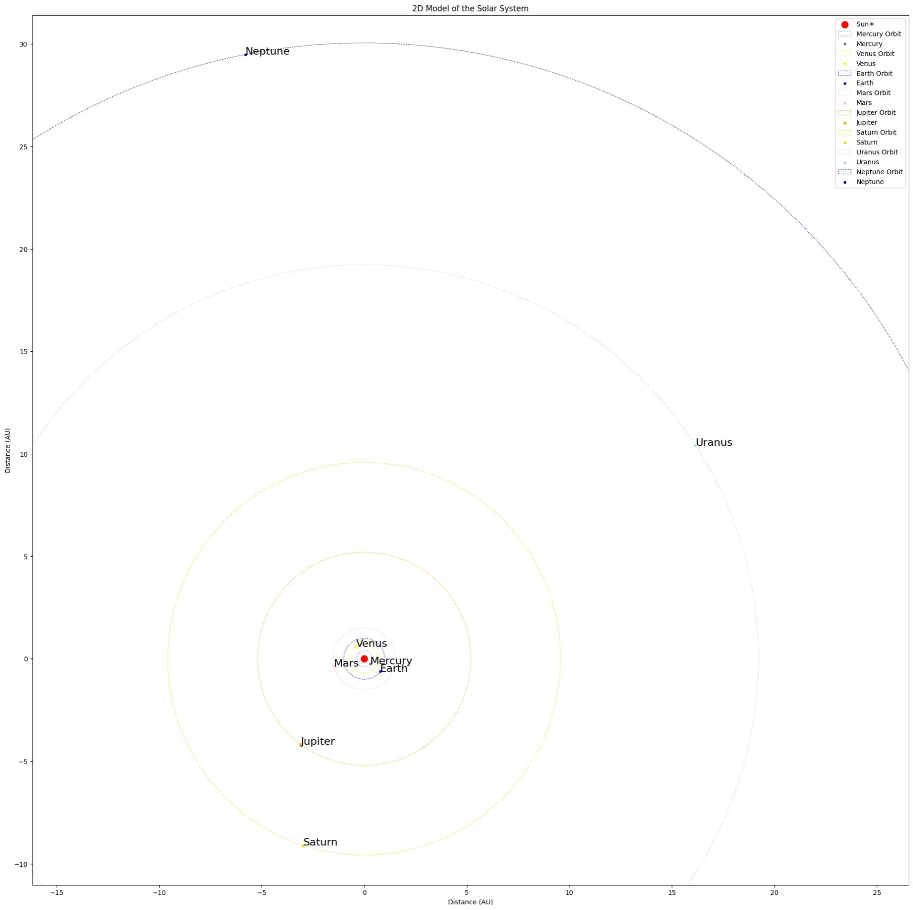
Timelines of 2 March 2006

Slide 10
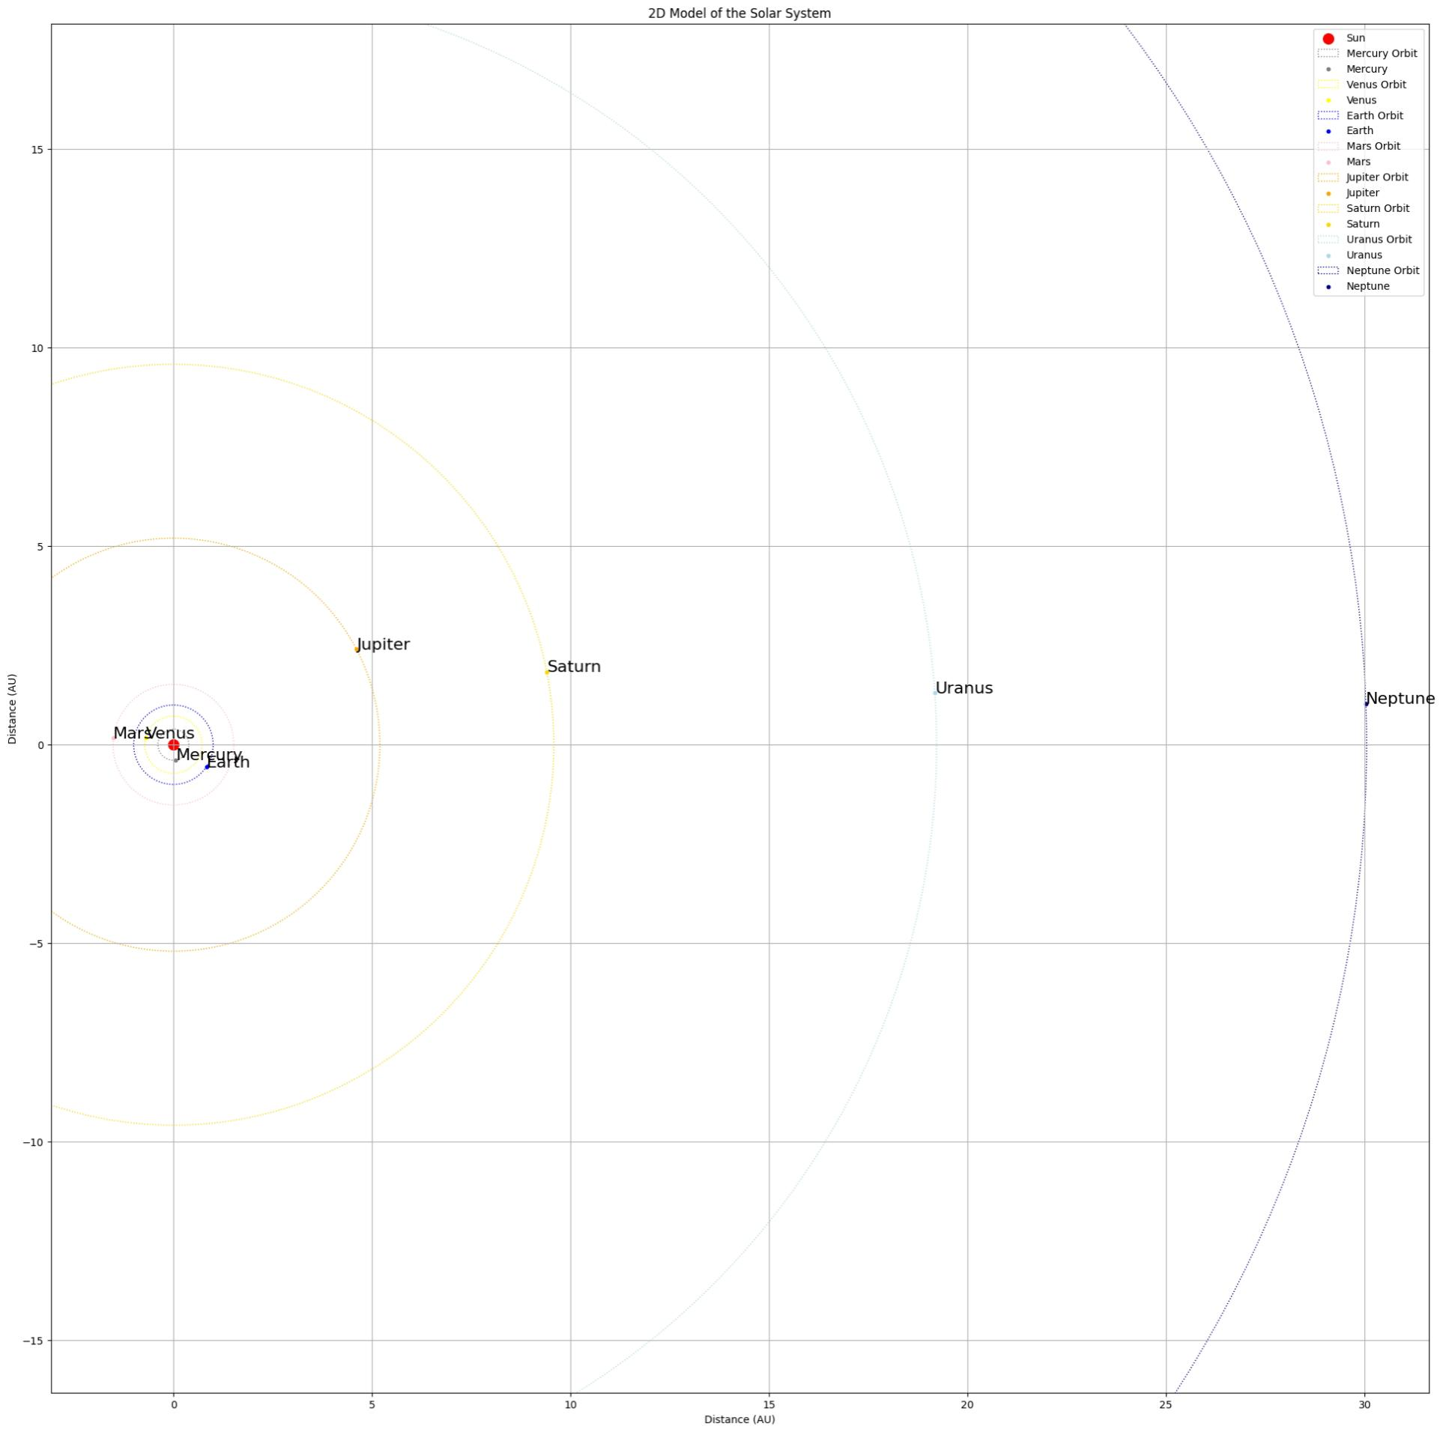
In 10 December 2024.

Slide 11
Future Enhancements
- Add elliptical orbits for more realistic trajectories
- Create an animated version of the solar system
- Include real-time spacecraft tracking
- Add moons for major planets

Slide 12
Conclusion
- The project provides an interactive 2D solar system simulation
- Users can calculate distances and travel times dynamically
- A practical of Python for educational purposes.

